Slide 1
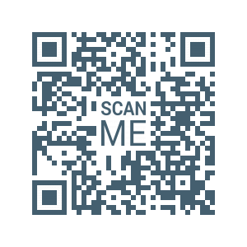

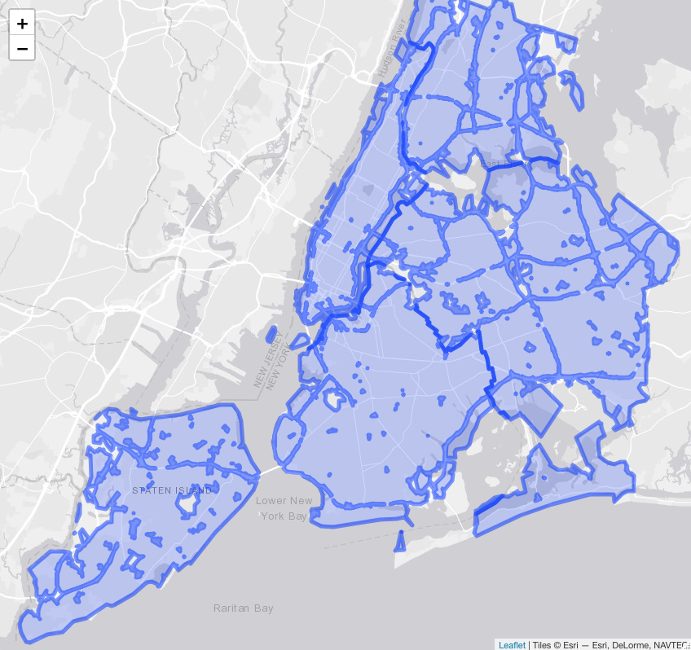
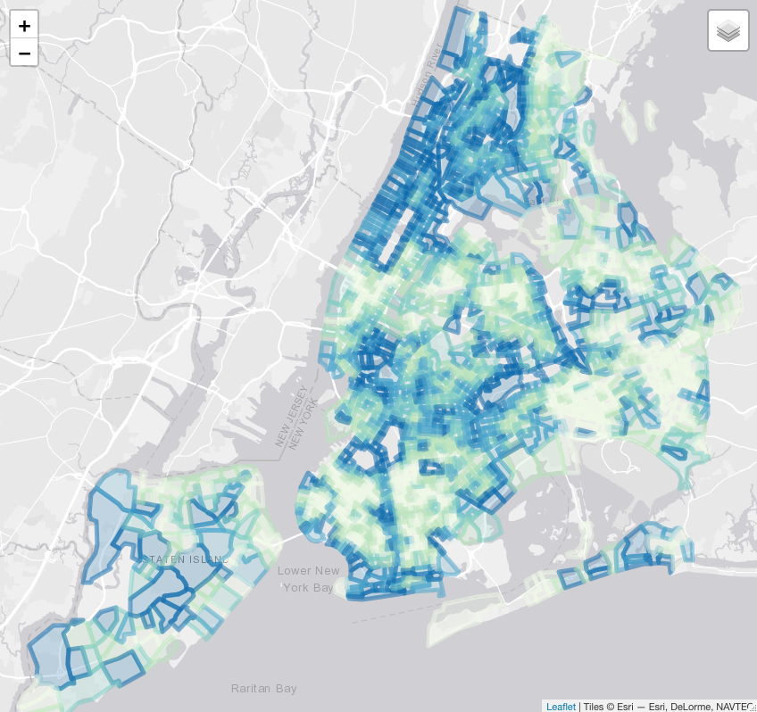
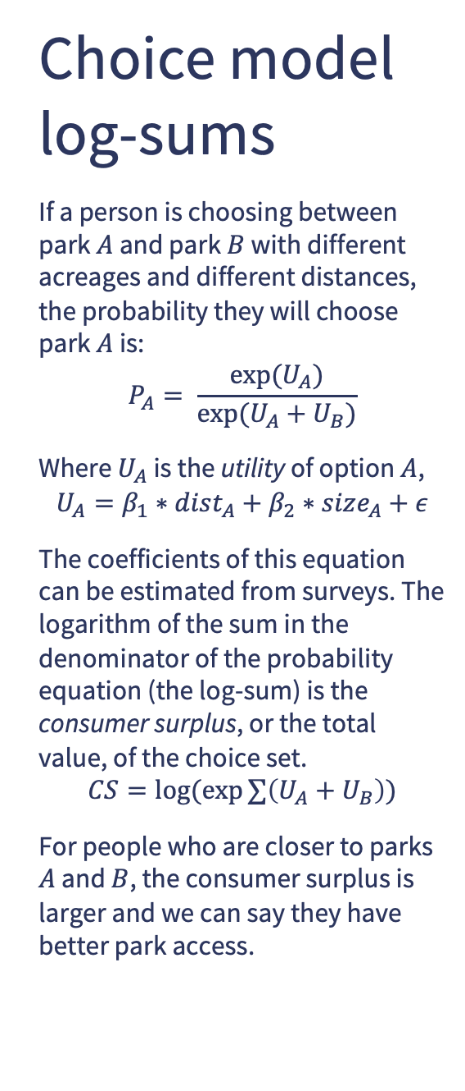
Choice theory can help measure gradations in park access.
Highlights
In places with many parks, most people will have 10-minute walk access. But this does not mean all access is the same.
If we can establish how far people are willing to travel to access different park amenities, then we can create a continuous accessibility measure.
The continuous measure may be more helpful in estimating park benefits at a neighborhood level.
In this case,
Summary
Recent research has underscored the potential for public green spaces to influence individual and societal health outcomes, but empirical measurements of such influences have yielded mixed results to date, with particular disagreement surrounding how access to parks ought to be defined while controlling alternate explanations. In this paper we present a comprehensive measure of park accessibility drawn from random utility choice theory, which avoids arbitrary assertions of proximity while incorporating potentially numerous amenities and attributes of both the parks and the population. We apply this choice-based accessibility measure to correlate Census tract-level obesity and physical activity rate estimates from the Centers for Disease Control and Prevention's 500 Cities project with tract-level American Community Survey socioeconomic data in New York City, paired with geographic parks data from New York City and geolocated tweet data collected from the Twitter API as a metric of a park's activity levels. Controlling for the socioeconomic variables and spatially correlated error terms, we show a positive and significant relationship between park access and physical activity rates, and a clear and significant negative relationship between park access and obesity rates. In doing so, this research contributes a new, more comprehensive modeling approach for measuring the impact of park access on health, and may improve our understanding of the role parks can serve in furthering public health objectives.
Greg Macfarlane¹, Nico Boyd², John E. Taylor³, Kari Watkins³
¹ Brigham Young University, Provo Utah
² Fehr and Peers, Los Angeles California
³ Georgia Institute of Technology, Atlanta Georgia
Park access is correlated with neighborhood-level health outcomes
Correspondence: gregmacfarlane@byu.edu
Choice model log-sums
If a person is choosing between park $A$ and park $B$ with different acreages and different distances, the probability they will choose park $A$ is:
$$P_{A}= \frac{exp⁡(U_{A})}{exp⁡(U_{A}+U_{B})}$$
Where $U_{A}$ is the utility of option $A$,
$$U_{A}=β_{1}∗dist_{A}+β_{2}∗size_{A}+ε$$
The coefficients of this equation can be estimated from surveys. The logarithm of the sum in the denominator of the probability equation (the log-sum) is the consumer surplus, or the total value, of the choice set.
$$CS=log⁡(exp∑\left(U_{A}+U_{B}\right))$$
For people who are closer to parks $A$ and $B$, the consumer surplus is larger and we can say they have better park access.
The Trust for Public Lands develops a “Park Score” for a city based on the percent of people who live within a 10-minute walk of a public park, the total public park acreage, and a number of other factors. This allows for cities to be easily compared against each other, but in a place like New York almost the entire city is within the threshold.
By weighting a neighborhood (census tract) based on the acreage of nearby parks and the travel costs, we can show that some neighborhoods have more options, and therefore more access, than others. This access is correlated with public health outcomes at the neighborhood level.
Next Steps
The measure of distance we used is just the straight-line distance from the population-weighted tract centroid to the boundary of the park. Two ways this could be better: first, using network distances that account for obstacles and barriers; second, using a multi-modal accessibility measure such as a mode choice log-sum to account for different travel options. We would also like to use coefficients estimated from surveys or other data instead of coefficients asserted by us.
Notes:
Notes:
In Powerpoint, click View > Guides
Keep text within gutter guides.
Author list: Don’t split names onto two lines (e.g., “Jimmy [break] Smith”). If that happens, use a new line, unless you need the space. Bold the first names of anybody who’s presenting in person.
Intro/methods/result: Do not drop below font size 28, but if you have extra space, jack up the font size until the space is full.
Do not use color in the sidebars except in graphs/figures. It’ll pull attention from the center and slow interpretation for passersby.

